Slide 1
TEKLUSIA Natura 2000- Special Area Of Conversavation
Area code: PLH160017
A form of protection under Natura 2000: Special Area Of Conversavation
Biogeographical area: Continental
Area: 316,5 ha
Formal status: The area was approved by Decision of the European Commission

Slide 2
The area is located in reduction valley of tributary of Wołczyńska Struga, slightly cutting contiguous upland postglacial. Floor of the valley is flat, lined by fen soil, silt and peat.
Teklusia is one of a few areas with preserved, varied natural habitat in agriculture landscape of Silesian Lowlands
An essential element of the landscape of this area are small meadows and pastures surrounded by fragments of forest. Its central part, once used as meadows and pastures. In the second half of the twentieth century was secondary paludification in a result of the cessation of the economy to meadow and the lack of renewal of the system of drainage ditches and drains.
The current plant communities here represent wetland sedge rushes, marshes and meadow variable humidity, as well as fresh meadows.

Slide 3
Distribution of habitats

Slide 4
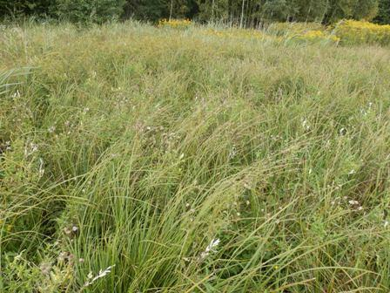
6410 Molinia meadows

Slide 5
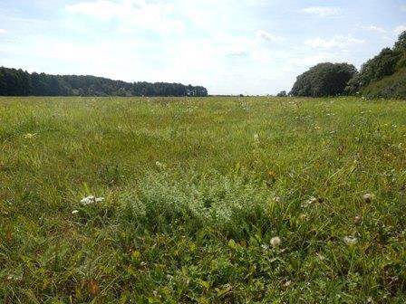
6510 Lowland hay meadows

Slide 6
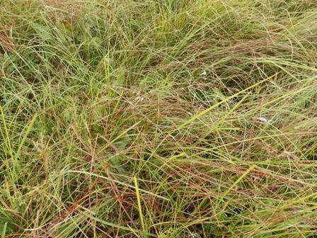
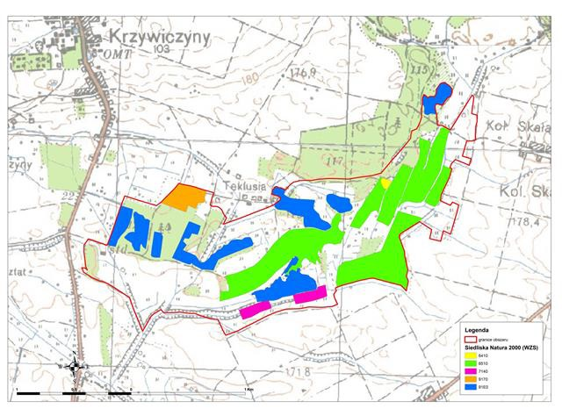
7140 Transition mires and quaking bogs

Slide 7
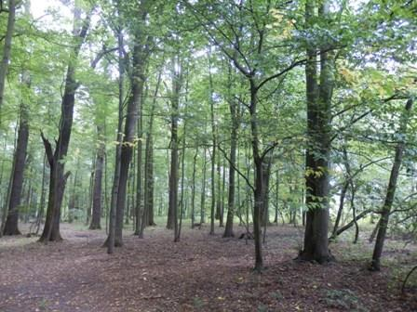
9170 Oak-hornbeam forrest

Slide 8
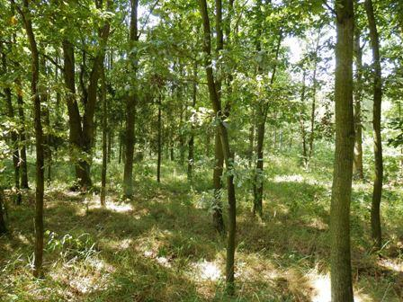
9190 Old acidophilous oak woods

Slide 9
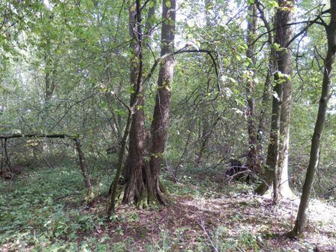
91E0 Alluvial alder-ash forests

Slide 10
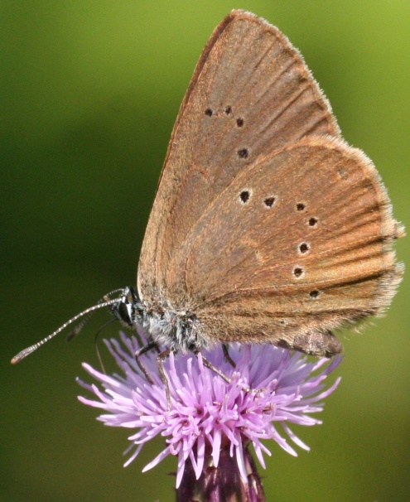
The southern part was settled by beavers, which contributed to additional area flooding.
The area is potentially very valuable for insects fauna (among others dusky large blue (Maculinea nausitous) and scarce large blue (Maculinea telejus).
These areas are also valuable as birds' habitat, both breeding and migrant, especially in the period of spring thaw.

Slide 11
In the breeding season there is special aggregation of species, including 6 species of accipitriformes birds with the rarest: the red kite (Milvus milvus) and the black kite (Milvus migrans).
The red kite
The black kite

Slide 12
There are also numerous populations of other species, which are important for Europe: the corn crake (Crex crex), the western marsh harrier (Circus aeruginosus), the red-backed shrike (Lanius collurio).
The western marsh harrier
The red-backed shrike

Slide 13
Threats:
The most serious threats are:
secondary succession,
overseeding blends of grass forages and dredge ditches,
eutrophication and development of nitrophilous groups with the domination of stinging nettles, due to pouring sewage from Wołczyń,
the planned construction reservoir- the tank would adhere directly to southern borders of the refuge.

Slide 14
Tourism:
The area is comparatively easily accessible by car. You can get there by Namysłów-Kluczbork road, to Wołczyn, and then local roads, to the north. Specific natural values represent about place attractiveness and foster the development of eco-tourism.
The area offers all forms of relax related with forest resources.
Tourists use the services of agritourism farms.
In the municipality Wołczyn it was designated cycle path: trail of wooden churches.
In neighborhood it is worth visiting churches in Miechowa from XVI century, in Komorzno from XVIII century, in Proślice from XVI century and in Brzezinki from XVI century.

Slide 15
References:
The documentation for the development of a draft plan of protection tasks for the area Teklusia PLH160017, Regional Directorate for Environmental Protection in Opole
www.opole.rdos.gov.pl/natura-2000
www.namyslow.katowice.lasy.gov.pl
www.wolczyn.pl
www.przyrodaslaska.pl
http://natura2000.eea.europa.eu/#

