Slide 1
White-tailed eagle
Created by: Mateusz Hurnik, Mateusz Waloszczyk, Anna Respondek Publiczne Gimnazjum im J.P.II w Dobrodzieniu , II klasa gimnazjum

Slide 2
Table of Contents
Reasons of title
Appearance
Appearance part 2
Classification
Diet
Occurrence
Occurrence range
Sounds
Bibliography

Slide 3
Reasons of title
The reason why I picked this title is that near my village J.Włodarz saw and photograph this rare in Poland bird. Photos in the next slides were made by him using his specialized camera. I first saw this photos in local House of Culture.

Slide 4
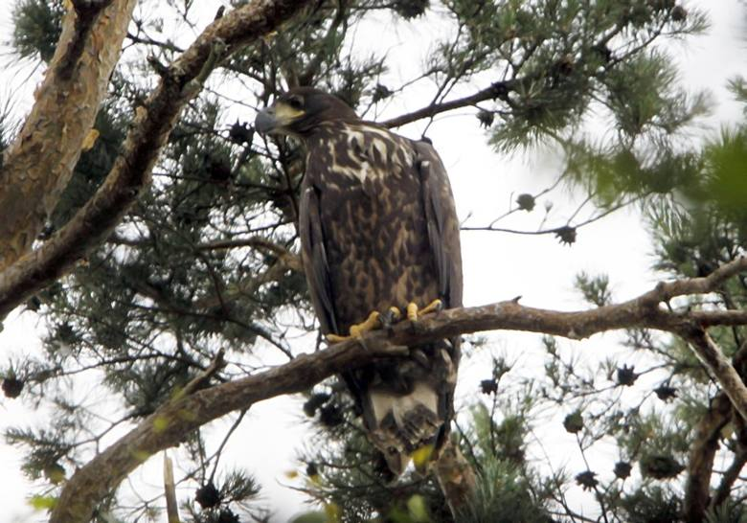
Appearance
It’s beak has specific shape to help it in eating meat
Body length: 76-98cm
Wingspan: 200-245cm

Slide 5
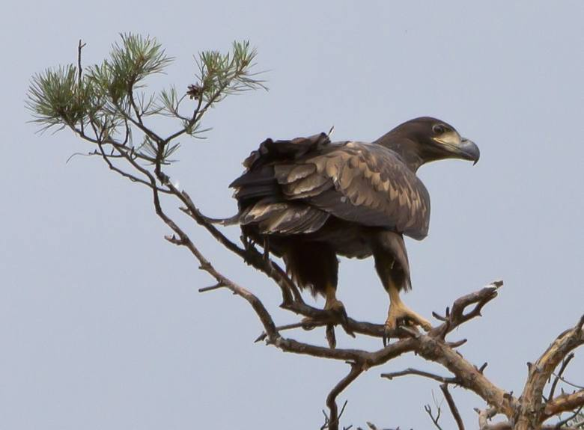
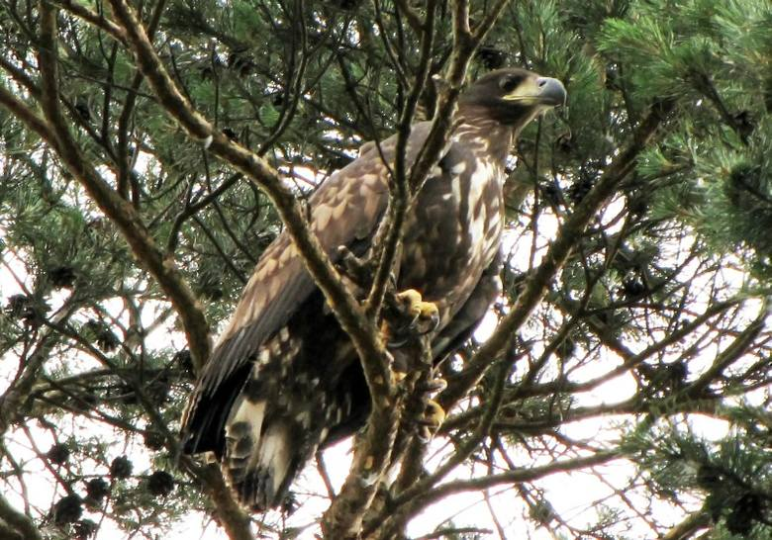
Appearance Part 2

Slide 6
Classification
Kingdom: Animalia
Phylum: Chordata
Class: Aves
Order: Accipitriformes
Family: Accipitridae
Genus: Haliaeetus
Species: H. albicilla

Slide 7
Diet
White-tailed eagle eats big fishes, water birds, mammals and carrion.
It eats 500g of meat in reproduction season and 200-300g in winter.

Slide 8
Occurrence
North and North-East of Europe
It makes it’s nests near middle-big lakes, rivers which are near forests or bigger group of trees
White-tailed eagle has least concern status in Conservation status scale

Slide 9
Occurrence range
Light green=Nesting range, blue=Wintering range,
dark green=Year-round range

Slide 10
Sounds
Click speaker and wait a few seconds to play the sound
I am sorry for trouble, but I can not do anything more

Slide 11
Bibliography
Wikipedia
„Rośliny i zwierzęta” część4/5 ISBN:978-83-7552-337-9
„Atlas ptaków” część 1 ISBN: 978-83-268-0118-1
https://www.youtube.com/watch?v=1-5puK33aK8

